Slide 1
E-LEARNING PORTAL
SK EDUCATION SDN BHD

Slide 2
E-LEARNING PORTAL
Courses
Homework / Assessment
Competition / Games
Dual Language (Mandarin & English)

Slide 3

Header
Home
Courses
Testimonials
Pricing/Promotion
Announcements/Newsletter
FAQ/Guide/Manual
Customer Login
Announcement Banner
Duration Period

Slide 4

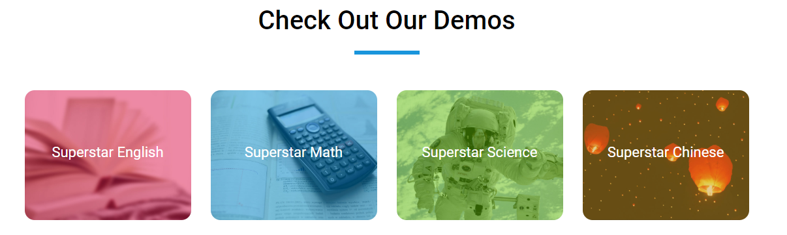

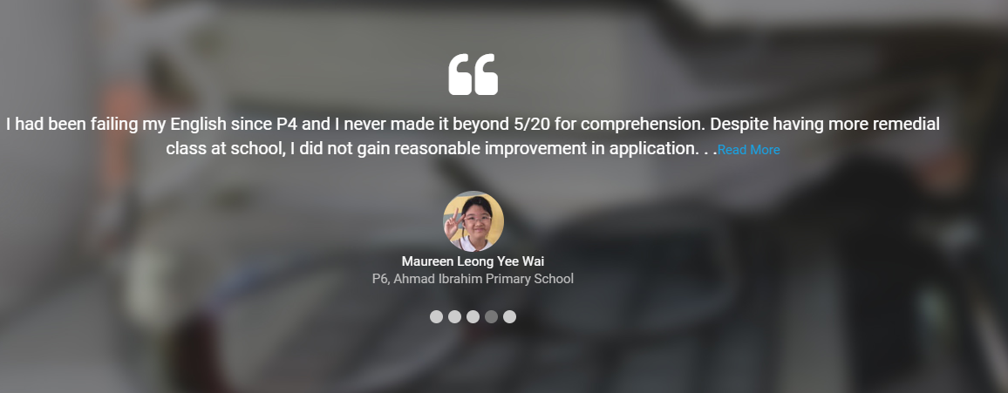
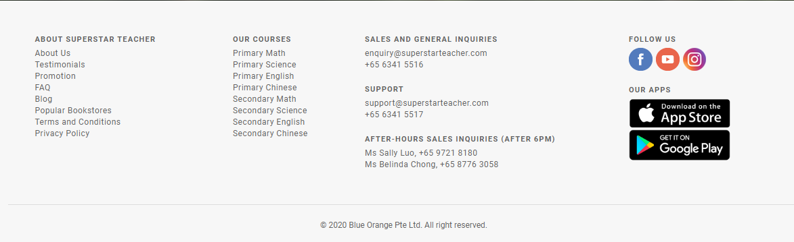
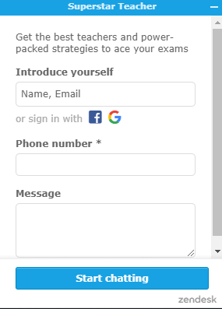
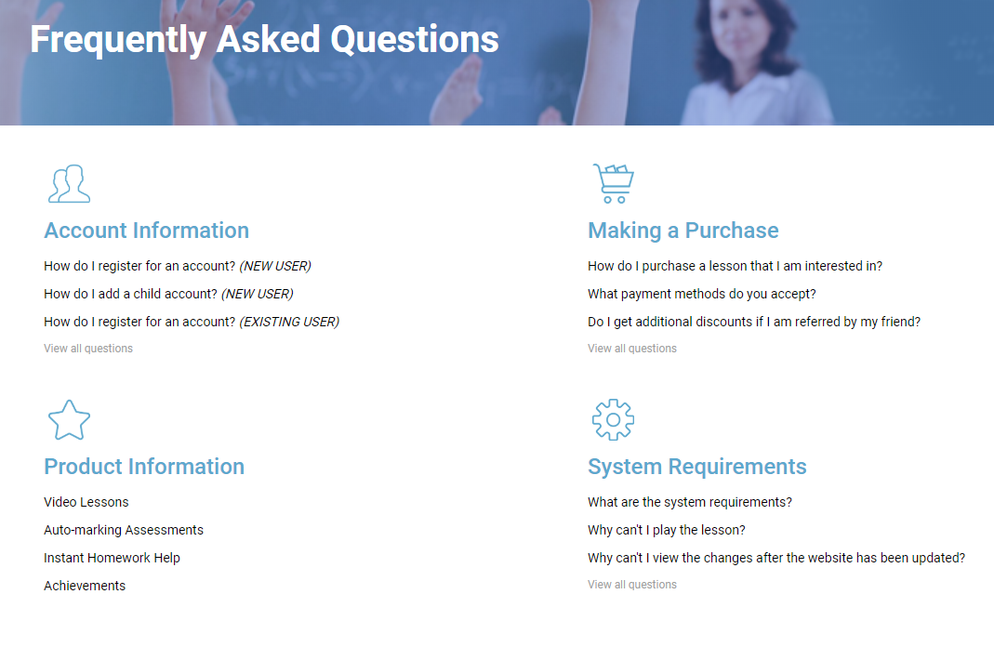
Home Page
1
2
Introduction
Courses Demo
Testimonials
Company/Teacher’s Profile & Biography
Links
Official Website
FAQ
Terms and Conditions
Privacy Policy
Sales & General Enquiries
Support
Leave a Message
Name
Email
Phone Number
Category
Course/Lesson
Sales
General
Message
4
3
5
6
5(b)

Slide 5
Courses Page
Note:
Description for Each Courses
Add to Cart to Select Programmes within the Selected Course
Online/Offline Student will have separate account as per Payment App – offline student to sign up for standalone coursework
Mental Arithmetic (Chinese)
Mental Arithmetic (English)
Mental Arithmetic Teacher’s Training (Chinese)
Mental Arithmetic Teacher’s Training (English)
Financial Planning

Slide 6
Programmes Page
Note:
Display Programmes of Selected Course
Description for Each Programmes
Add to Cart for Each Programmes
Mental Arithmetic (Chinese)
Basic
Elementary
Intermediate
Advanced
*Grand Level – Not available for this programme, PM for online lesson
Challenges
Levelling Paper Module
Competition Paper Module
Flash Calculation Module
Oral Calculation
Student’s Ranking
Coursework (Offline Student)
Mental Arithmetic (English)
Basic
Elementary
Intermediate
Advanced
*Grand Level – Not available for this programme, PM for online lesson
Challenges
Mental Arithmetic Teacher’s Training (Chinese)
Mental Arithmetic Teacher’s Training (English)
Financial Planning

Slide 7
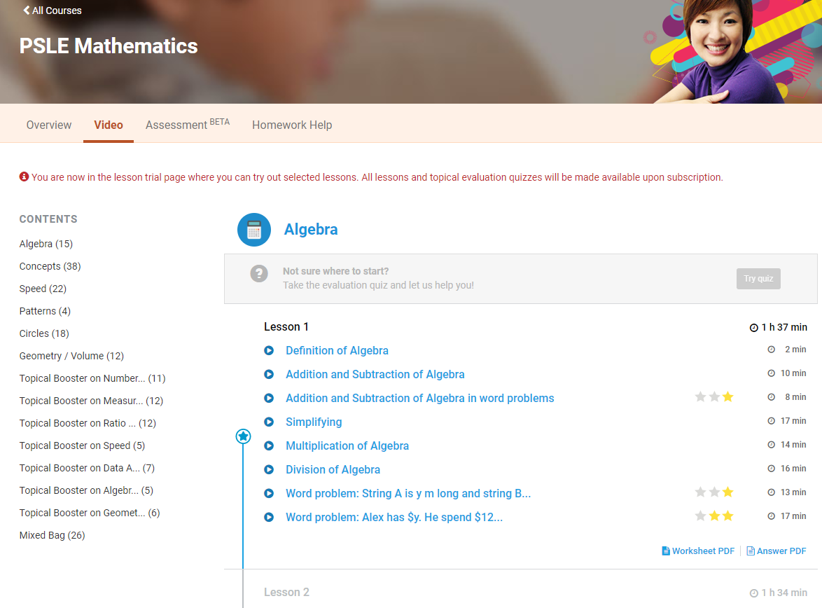
Programme Page
Note:
Videos/File/Homework/Assessment/Competition/Games to be viewed upon sign-in
Programme Overview
Programme Description
Number of Lessons
Video/Files
Demo Lesson (For non-sign in customers)
Upload Content Includes Video & PDF Files & Photos (JPEG/PNG/JPG)
MCQ Question Pop-Up Window
Admin to Upload Materials & Define Courses & Pricing
One-time pay-off and payment term mode
Premium Package with Live-Teaching (Zoom)
Live-Teaching Scheduling (Teacher to Define Slots) – Student to select slot from the defined slots? No changes allow
Teacher’s Training will be a Course by itself – admin to control view access for teachers
Chinese/English Lesson Can be Individual Course by Itself
Financial Planning can be Individual Course by Itself
Homework/Assessment
Excel File Upload (template)
PDF File Upload (Competition Paper - For Printout Purpose)
Student Instant Answer & Instant Marking/Result Display
Allow Correction for Wrong Answers
Completed Homework History
Teachers Access to Student’s Result

Slide 8
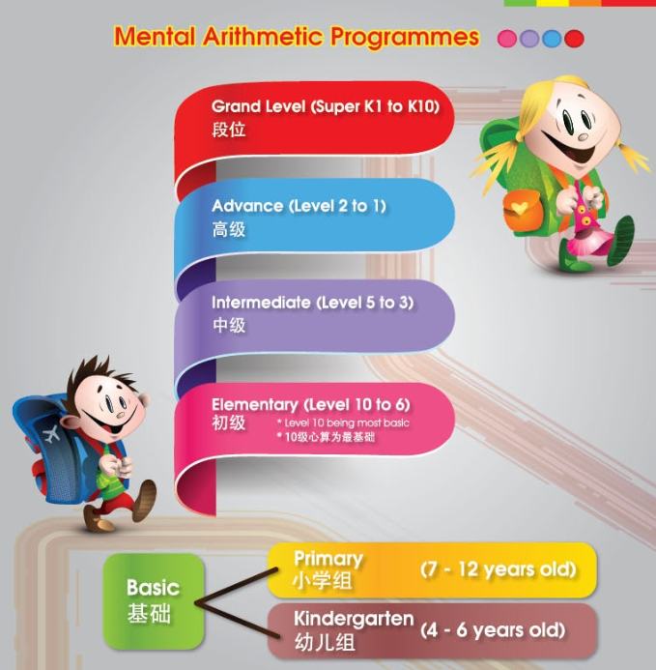
Programmes Structures
Please refer to the specific requirements for all programmes on next pages
Basic + Elementary (Lesson 1-4)
Elementary (Lesson 5-14) + Intermediate + Advanced
LESSON 1
LESSON 5
LESSON 6
Video
VIDEO 1
Video
VIDEO 1
Video
VIDEO 1
IF FAIL
Level Homework (Level 10)
Allow 1-time correction
Level Homework (Level 10)
Allow 1-time correction
Homework
Allow 1-time correction
IF PASS
IF FAIL
Homework
Allow 1-time correction
IF FAIL
Allow 1-time correction
Homework
Homework
Video
VIDEO 2
IF PASS
IF PASS
IF FAIL
Next assessment will be still Level 9 assessment
Homework
Allow 1-time correction
Video
VIDEO 2
IF PASS
Level Homework (Level 10)
Allow 1-time correction
LESSON 6
IF FAIL
Video
VIDEO 1
Assessment
IF PASS
IF FAIL
Homework
Allow 1-time correction
Allow 1-time correction
Level Homework (Level 9)
LESSON 2
VIDEO 1
IF PASS
Video
IF FAIL
Allow 1-time correction
Homework
IF FAIL
Level Assessment
(Level 9)
IF FAIL
Homework
Allow 1-time correction
IF PASS
IF PASS
Next assessment will be Level 8 assessment
IF PASS

Slide 9
Lessons (1)
Basic
9 lessons, 63 videos, few pages of homework per video, assessment for each lessons
Lesson
Video | Homework | Assessment
Must view through >90% video to unlock homework and video slider Approximately 15min each video | Allow 1-time correction for homework, after correction need >60% to pass Applicable for all videos Only for 1st page of the homework Admin can decide to select option to unlock or not for next video If pass: Unlock next video If fail: Re-take, video and homework remain unlock (video slider remain unlock) Count-up timer for homework | Assessment need >60% to pass Applicable for each lessons Admin can decide to select option to unlock or not for next video If pass: Unlock next video If fail: Re-take, video and homework remain unlock (video slider remain unlock) Fail 3 times assessment need to trigger email to admin Count-down timer for assessment (admin to define the time) – 30min
1. Passing percentage to be defined by admin

Slide 10
Lessons (2)
Elementary
14 lessons, 72 videos, few pages of homework per video, assessment for each lessons
Lesson 1 – 4
Video | Homework | Assessment
Must view through >90% video to unlock homework and video slider Approximately 15min each video | Allow 1-time correction for homework, after correction need >60% to pass Applicable for all videos Only for 1st page of the homework Admin can decide to select option to unlock or not for next video If pass: Unlock next video If fail: Re-take, video and homework remain unlock (video slider remain unlock) Count-up timer for homework | Assessment need >60% to pass Applicable for each lessons Admin can decide to select option to unlock or not for next video If pass: Unlock next video If fail: Re-take, video and homework remain unlock (video slider remain unlock) Fail 3 times assessment need to trigger email to admin Count-down timer for assessment (admin to define the time) – 30min
Lesson 5 – 14
Video | Homework | Level Assessment | Level Homework
Must view through >90% video to unlock homework and video slider Approximately 15min each video | Allow 1-time correction for homework, after correction need >60% to pass Applicable for all videos Only for 1st page of the homework Admin can decide to select option to unlock or not for next video If pass: Unlock next video If fail: Re-take, video and homework remain unlock (video slider remain unlock) Count-up timer for homework | Assessment need >70% to pass Applicable for each lessons Admin can decide to select option to unlock or not for next video If pass: Unlock next video & move to next level If fail: Unlock next video & stay with current level Fail 3 times assessment need to trigger email to admin Count-down timer for assessment (admin to define the time) – 3min | Allow 1-time correction for homework If pass/fail: Next defined pages homework for current level Count-up timer for homework
1. Passing percentage to be defined by admin

Slide 11
Lessons (3)
Intermediate
12 lessons, 52 videos, few pages of homework per video, assessment for each lessons
Lesson
Video | Homework | Level Assessment | Level Homework
Must view through >90% video to unlock homework and video slider Approximately 15min each video | Allow 1-time correction for homework, after correction need >60% to pass Applicable for all videos Only for 1st page of the homework Admin can decide to select option to unlock or not for next video If pass: Unlock next video If fail: Re-take, video and homework remain unlock (video slider remain unlock) Count-up timer for homework | Assessment need >70% to pass Applicable for each lessons Admin can decide to select option to unlock or not for next video If pass: Unlock next video & move to next level If fail: Unlock next video & stay with current level Fail 3 times assessment need to trigger email to admin Count-down timer for assessment (admin to define the time) – 3min | Allow 1-time correction for homework If pass/fail: Next defined pages homework for current level Count-up timer for homework
1. Passing percentage to be defined by admin

Slide 12
Lessons (4)
Advanced
7 lessons, 37 videos, few pages of homework per video, assessment for each lessons
Lesson
Video | Homework | Level Assessment | Level Homework
Must view through >90% video to unlock homework and video slider Approximately 15min each video | Allow 1-time correction for homework, after correction need >60% to pass Applicable for all videos Only for 1st page of the homework Admin can decide to select option to unlock or not for next video If pass: Unlock next video If fail: Re-take, video and homework remain unlock (video slider remain unlock) Count-up timer for homework | Assessment need >70% to pass Applicable for each lessons Admin can decide to select option to unlock or not for next video If pass: Unlock next video & move to next level If fail: Unlock next video & stay with current level Fail 3 times assessment need to trigger email to admin Count-down timer for assessment (admin to define the time) – 3min | Allow 1-time correction for homework If pass/fail: Next defined pages homework for current level Count-up timer for homework
1. Passing percentage to be defined by admin

Slide 13
Online Challenge Program (1)
Set 1 (by Level Paper) | Set 2 (Competition Paper) | Set 3 (Flash Calculation) | Set 4 (Oral Calculation)
12 Stages Level 10, 9, 8, 7, 6, 5, 4, 3, 2, 1, Grand Level 1, Grand Level 2 Student can select whichever stage to challenge as they wish Questions 15 questions/set Student can do as many sets of paper possible within specified timeframe Auto question generator (random number generator) to generate all the questions according to number of lines & number of digits Fix number of lines & number of digits based on stages (admin to control number of lines and number of digit for each stages) Countdown timer 3 min Operation Add & minus After each operation cannot be negative & answer cannot be negative Don’t repeat previous number Multiply/divide (digit) x (digit) (digit) / (digit) For division, answer cannot have remainder, must be an integer | 8 Stages Preschool (No Formula) – defined questions, Preschool (Formula), Kindergarten 1, Kindergarten 2, Kindergarten 3, Primary 1, Primary 2, Primary 3, Secondary 1, Secondary 2, Secondary 3 Student can select whichever stage to challenge as they wish Questions 60 questions/set Student can only do 1 set of paper within the specified timeframe Auto question generator (random number generator) to generate all the questions according to number of lines & number of digits Fix number of lines & number of digits based on stages (admin to control number of lines and number of digit for each stages) Countdown timer 3 min | 5 Stages 1 digit, 2 digit, 3 digit, 4 digit, 5 digit (admin to control number of digit) Student can select whichever stage to challenge as they wish Questions 30 questions/set Display mode: Flash – display line by line for each question, followed by answer input, then repeat same flow for the next question Auto question generator (random number generator) to generate all the questions according to number of lines & number of digits Fix number of lines for each set of question as below Q1-Q5 -> 5 lines Q6-Q10 -> 10 lines Q11-Q15 -> 15 lines Q16-Q20 -> 20 lines Q21-Q25 -> 25 lines Q26-Q30 -> 30 lines Countdown timer 5 min 4 modes of speed Slow – Normal – Fast – Very Fast Allow student to change the speed of the question display instantly – live | 5 Stages 1 digit, 2 digit, 3 digit, 4 digit, 5 digit (admin to control number of digit) Student can select whichever stage to challenge as they wish Questions 30 questions/set Display mode: Oral – Speak (text-to-speech) line by line for each question, followed by answer input, then repeat same flow for the next question Auto question generator (random number generator) to generate all the questions according to number of lines & number of digits Fix number of lines for each set of question as below Q1-Q5 -> 5 lines Q6-Q10 -> 10 lines Q11-Q15 -> 15 lines Q16-Q20 -> 20 lines Q21-Q25 -> 25 lines Q26-Q30 -> 30 lines Countdown timer 5 min 4 modes of speed Slow – Normal – Fast – Very Fast Allow student to change the speed of the question display instantly – live

Slide 14
Online Challenge Program (2)
Student Ranking Display
Result will be filtered according to the time student accomplished the challenge
Select Set
Select Stages
Select Year & Quarter (Default display the latest year and quarter result)
Items to display
Student picture
Student name
Question answered correctly
Date student completed the challenge

Slide 15
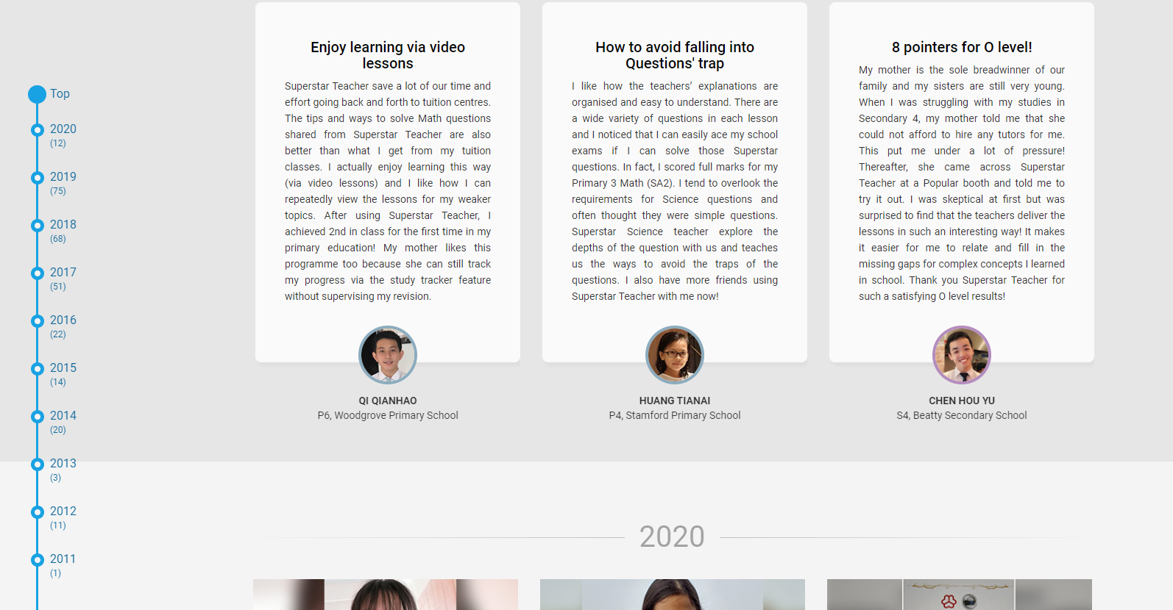
*Testimonials Page
Timelines of Events
Descriptions of the past events according to yearly timeline
Written
Video

Slide 16
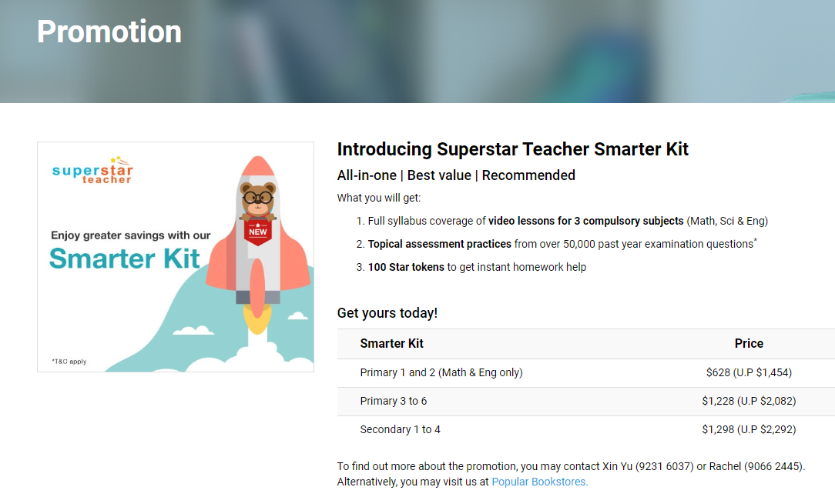
Pricing/Promotion Page
Courses Pricing
List of All Pricing According to Courses
Link to Subscription/Payment Page
On-Going Promotions
Description of all promotions
Link to Subscription Page
After payment:
Thank you page (customer)
Welcome on-board + Video Introduction (customer)
Notification of subscription (admin)
Before payment:
Reconfirmation of Purchase & Add-On Sides (Promotion Products/Bundles)
Can this support other currency?

Slide 17
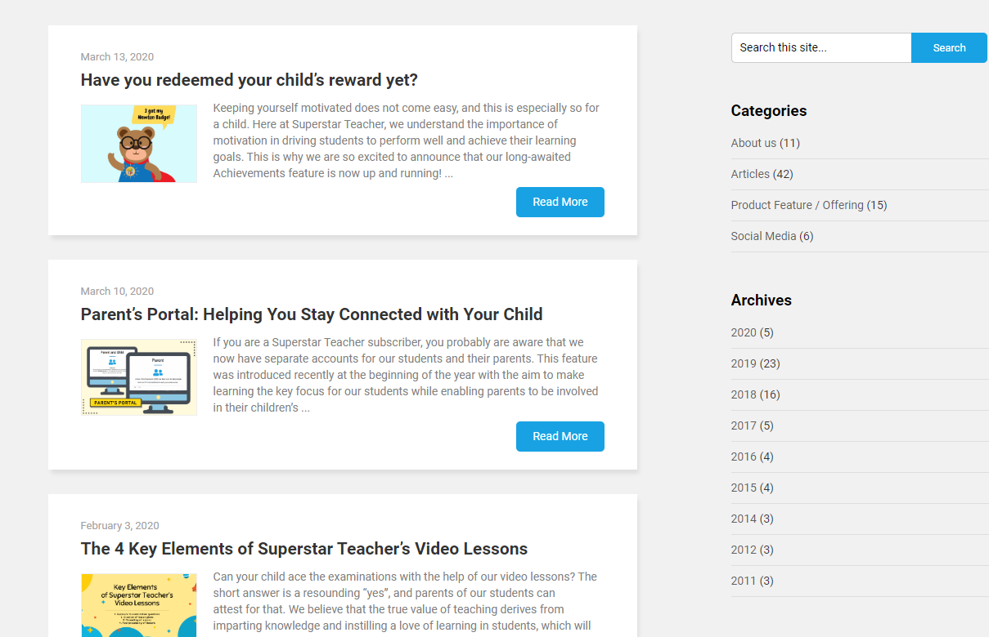
Announcement/Newsletter Page
List of Announcement/Newsletter
Additional Notification Medium
SMS?
Email?
Watsapp?

Slide 18
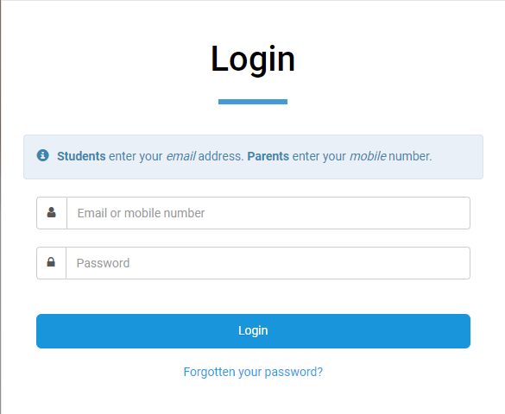
Customer Login
Online/Offline Customer Login
Online customer: Need to subscribe on E-Learning and purchase courses/programmes, student will receive a login username and password
Offline customer: Need to subscribe through E-Learning platform similar to online student, but can purchase coursework only for offline student which will have access to games/competition.
Online Customer: Customers that subscribe to our E-Learning platform
Offline Customer: Customers that subscribe to in-classroom teaching

Slide 19
Dashboard (Profile Page)
Customers’ Profile
Student Name (English & Chinese)
Profile Picture
Date of Birth
Gender
School Name
Kindergarten
Primary
Secondary
Address
Guardian 1
Name
Relationship
Occupation
Contact 1
Contact 2
Email
Guardian 2
Name
Relationship
Occupation
Contact 1
Contact 2
Email
Registration Date
Product/Plan Purchased/Signed-Up
Others (TBD)

